Slide 1
LESSON 11

Slide 2
Overview
of
Previous Lesson(s)

Slide 3
Over View
A token is a pair consisting of a token name and an optional attribute value.
A pattern is a description of the form that the lexemes of a token may take.
In the case of a keyword as a token, the pattern is just the sequence of characters that form the keyword.
A lexeme is a sequence of characters in the source program that matches the pattern for a token and is identified by the lexical analyzer as an instance of that token.

Slide 4
Over View..
A regular expression is a sequence of characters that forms a search pattern, mainly for use in pattern matching with strings.
The idea is that the regular expressions over an alphabet consist of the alphabet, and expressions using union, concatenation, and *, but it takes more words to say it right.
Each regular expression r denotes a language L(r) , which is also defined recursively from the languages denoted by r's subexpressions.

Slide 5
Over View…
As an intermediate step in the construction of a lexical analyzer, we first convert patterns into stylized flowcharts, called "transition diagrams”.
Transition diagrams have a collection of nodes or circles, called states
Each state represents a condition that could occur during the process of scanning the input looking for a lexeme that matches one of several patterns.
Edges are directed from one state of the transition diagram to another.
Each edge is labeled by a symbol or set of symbols.

Slide 6
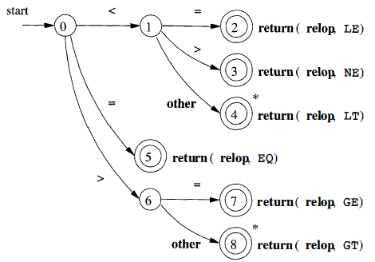
Over View…
A transition diagram that recognizes the lexemes matching the token relop.

Slide 7
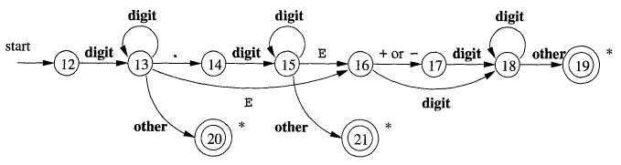
Over View…
The transition diagram for token number

Slide 8
Over View…
Finite automata are like the graphs in transition diagrams but they simply decide if a sentence (input string) is in the language (generated by our regular expression).
Finite automata are recognizers, they simply say "yes" or "no" about each possible input string.
Deterministic finite automata (DFA) have, for each state, and for each symbol of its input alphabet exactly one edge with that symbol leaving that state.
So if you know the next symbol and the current state, the next state is determined. That is, the execution is deterministic, hence the name.

Slide 9
Over View…
Nondeterministic finite automata (NFA) have no restrictions on the labels of their edges. A symbol can label several edges out of the same state, and ɛ, the empty string, is a possible label.
Both deterministic and nondeterministic finite automata are capable of recognizing the same languages.

Slide 10
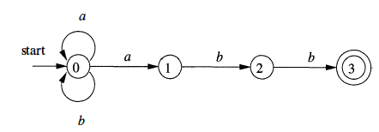
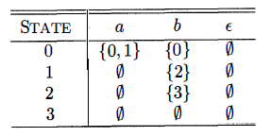
Over View…
Transition graph for an NFA recognizing the language of regular expression (a | b) * abb
Transition Table for (a | b) * abb

Slide 11
TODAY’S LESSON

Slide 12
Contents
Acceptance of Input Strings by Automata
Deterministic Finite Automata
Simulating a DFA
Regular Expressions to Automata
Conversion of an NFA to a DFA

Slide 13
Acceptance of Input Strings
An NFA accepts a string if the symbols of the string specify a path from the start to an accepting state.
These symbols may specify several paths, some of which lead to accepting states and some that don't.
In such a case the NFA does accept the string, one successful path is enough.
If an edge is labeled ε, then it can be taken for free.

Slide 14
Acceptance of Input Strings..
Ex. Reconsider the following TG
Now we will see how string aabb is accepted by the NFA.

Slide 15
Acceptance of Input Strings...
Ex. Reconsider the following TG
Now we will see how string aabb is accepted by the NFA.

Slide 16
Acceptance of Input Strings…
One more path leads to aabb

Slide 17
Acceptance of Input Strings…
One more path leads to aabb
This path leads to state 0, which is not accepting.
NFA only accepts a string as long as some path labeled by that string leads from the start state to an accepting state.
The existence of other paths leading to a non accepting state is irrelevant.

Slide 18
Deterministic Finite Automata
A deterministic finite automaton (DFA) is a special case of an NFA where:
There are no moves on input ε, and
For each state S and input symbol a, there is exactly one edge out of s labeled a.
If we are using a transition table to represent a DFA, then each entry is a single state.
we may therefore represent this state without the curly braces that we use to form sets.

Slide 19
Simulating a DFA
NFA is an abstract representation of an algorithm to recognize the strings of a certain language but the DFA is a simple, concrete algorithm for recognizing strings.
It is fortunate indeed that every regular expression and every NFA can be converted to a DFA accepting the same language.
Now we will see an algorithm that shows how to apply a DFA to a string.

Slide 20

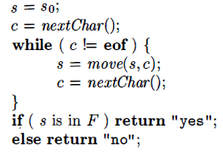
Simulating a DFA..
Apply this Algorithm to the input string x

Slide 21
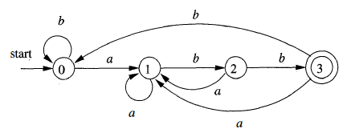
Simulating a DFA…
The function move(s, c) gives the state to which there is an edge from state s on input c.
The function next Char returns the next character of the input string x.
Ex. Transition graph of a DFA accepting the language (a|b)*abb, same as that accepted by the NFA previously.

Slide 22
RE to Automata
The regular expression is the notation of choice for describing lexical analyzers and other pattern-processing software.
Implementation of that software requires the simulation of a DFA, or perhaps simulation of an NFA.
NFA often has a choice of move on an input symbol or on ε, or even a choice of making a transition ε on or on a real input symbol.
Its simulation is less straightforward than for a DFA.
So it is important to convert an NFA to a DFA that accepts the same language.

Slide 23
Conversion of NFA to DFA
The general idea behind the subset construction is that each state of the constructed DFA corresponds to a set of NFA states.
PROCEDURE:
INPUT: An NFA N
OUTPUT: A DFA D accepting the same language as N.
METHOD: Construct a transition table Dtran for D. Each state of D is a set of NFA states, and construct Dtran so D will simulate "in parallel" all possible moves N can make on a given input string.

Slide 24
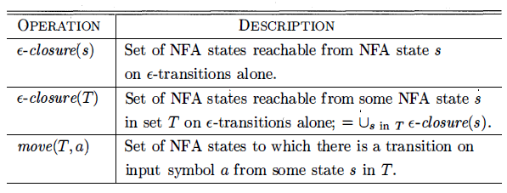
Conversion of NFA to DFA..
First issue is to deal with ɛ-transitions of N properly.
Definitions of several functions that describe basic computations on the states of N that are needed in the algorithm are described below:
Here s is a single state of N, while T is a set of states of N.

Slide 25
Conversion of NFA to DFA...
As a basis, before reading the first input symbol, N can be in any of the states of ɛ - closure(s₀), where S₀ is its start state.
For the induction, suppose that N can be in set of states T after reading input string x.
If it next reads input a, then N can immediately go to any of the states in move(T,a).
After reading a, it may also make several ɛ-transitions, thus N could be in any state of ɛ-closure(move(T,a) after reading input xa.

Slide 26
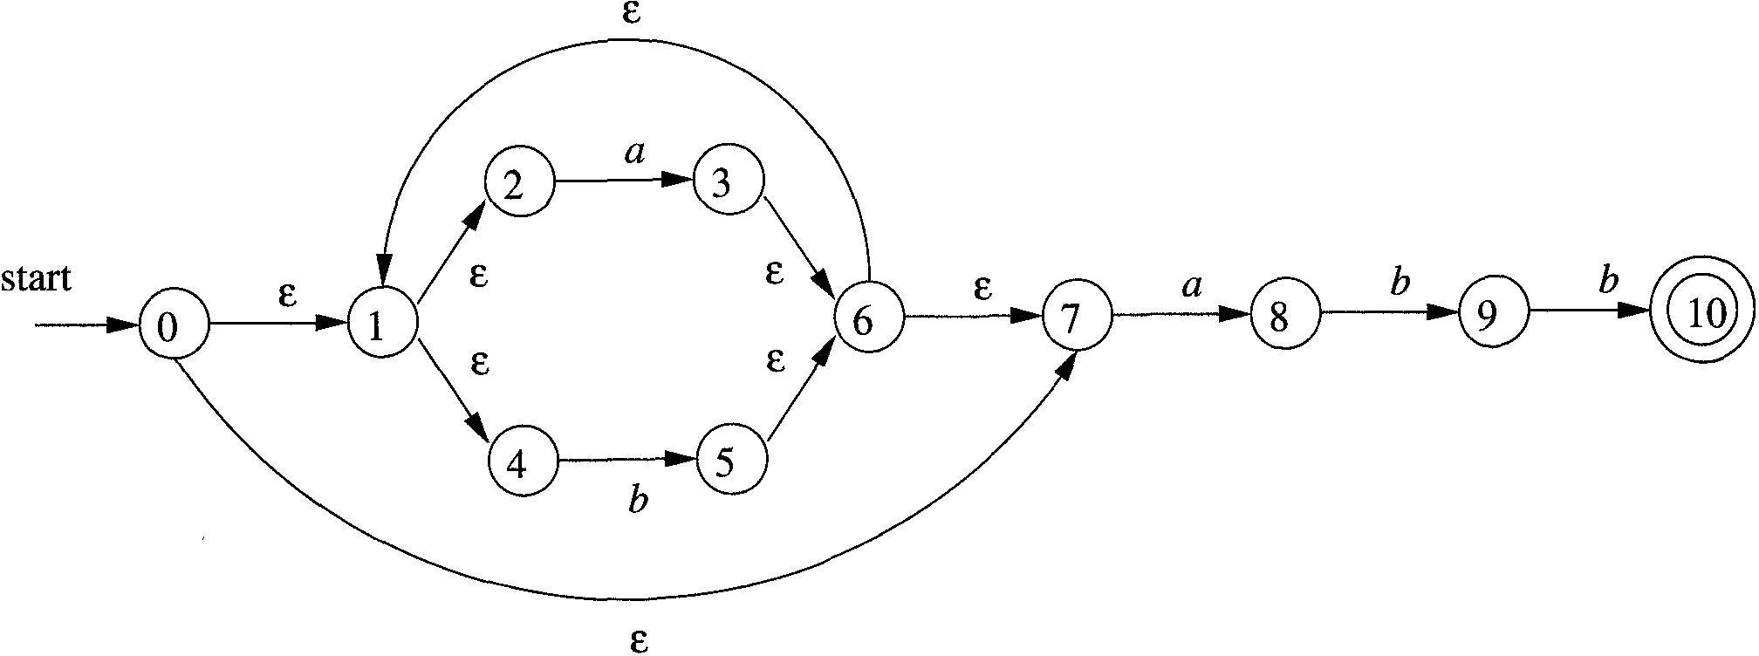
Conversion of NFA to DFA...
Ex. Let us consider the following transition graph, which is an NFA that accepts strings satisfying the regular expression (a|b)*abb. The alphabet is {a,b}

Slide 27
Conversion of NFA to DFA...
The start state of D is the set of N-states that can result when N processes the empty string ε.
This is called the ε-closure of the start state s₀ of N, and consists of those N-states that can be reached from s₀ by following edges labeled with ε.
Calculation of ɛ-closure(0) or D₀ ..

Slide 28
Conversion of NFA to DFA...
Calculation of D₀

Slide 29
Conversion of NFA to DFA...
The start state of D is the set of N-states that can result when N processes the empty string ε.
This is called the ε-closure of the start state s₀ of N, and consists of those N-states that can be reached from s₀ by following edges labeled with ε.
ɛ-closure(0) = D₀ = {0,1,2,4,7}
We call this state D₀ and enter it in the transition table
b | a | DFA States | NFA States
 |  | D₀ | {0,1,2,4,7}

Slide 30
Conversion of NFA to DFA...
Next we want the a-successor of D₀, i.e., the D-state that occurs when we start at D₀ and move along an edge labeled a.
We call this successor D₁.
Since D₀ consists of the N-states corresponding to ε, D₁ is the N-states corresponding to εa=a.
We compute the a-successor of all the N-states in D₀ and then form the ε-closure.
ɛ-closure(move(A,a) = D₁ = ?

Slide 31
Conversion of NFA to DFA...
Calculation of D₁: ɛ-closure(move(A,a) = ɛ-closure(move({0,1,2,4,7},a)

Slide 32
Conversion of NFA to DFA...
Next we want the a-successor of D₀, i.e., the D-state that occurs when we start at D₀ and move along an edge labeled a.
We call this successor D₁.
Since D₀ consists of the N-states corresponding to ε, D₁ is the N-states corresponding to εa=a.
We compute the a-successor of all the N-states in D₀ and then form the ε-closure.
ɛ-closure(move(A,a) = D₁ = {1,2,3,4,6,7,8}

Slide 33
Conversion of NFA to DFA...
Now Transition Table is.
Next we compute the b-successor of D₀ the same way and call it D₂.
b | a | DFA States | NFA States
 | D₁ | D₀ | {0,1,2,4,7}
 |  | D₁ | {1,2,3,4,6,7,8}

Slide 34
Conversion of NFA to DFA...
Calculation of D₂: ɛ-closure(move(D₀,b) = ɛ-closure(move({0,1,2,4,7},b)

Slide 35
Conversion of NFA to DFA...
Now Transition Table is.
b | a | DFA States | NFA States
D₂ | D₁ | D₀ | {0,1,2,4,7}
 |  | D₁ | {1,2,3,4,6,7,8}
 |  | D₂ | {1,2,4,5,6,7}

Slide 36
Conversion of NFA to DFA...
We continue forming a- and b-successors of all the D-states until no new D-states result.
So the final transition table is
b | a | DFA States | NFA States
D₂ | D₁ | D₀ | {0,1,2,4,7}
D₃ | D₁ | D₁ | {1,2,3,4,6,7,8}
D₂ | D₁ | D₂ | {1,2,4,5,6,7}
D₄ | D₁ | D₃ | {1,2,4,5,6,7,9}
D₂ | D₁ | D₄ | {1,2,4,5,6,7,10}

Slide 37
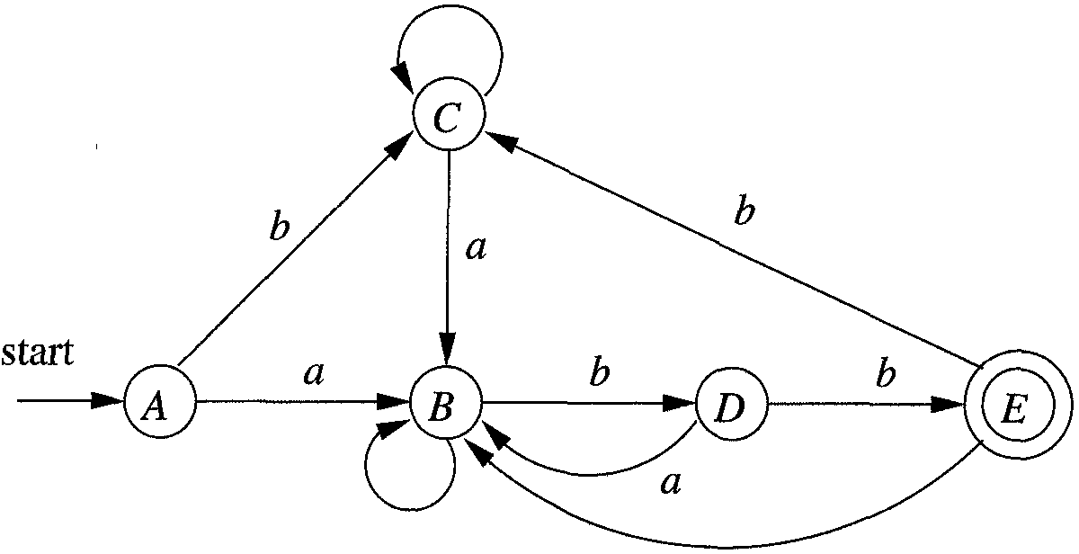
Conversion of NFA to DFA...
So after applying this result on the NFA we got

Slide 38
Thank You

